Slide 1
Lecture 33 – Floyd’s Algorithm
CST370 – Design & Analysis of Algorithms
Dr. Byun
Computer Science

Slide 2
Lecture Objectives
After completion of this lecture, you will be able to
  explain the operation of Floyd’s algorithm to find all pairs shortest paths in a graph.

Slide 3
Chapter 8: Dynamic Programming
8.1 Three Basic Examples
8.2 The Knapsack Problem and Memory Functions
8.3 Optimal Binary Search Trees
8.4 Warshall’s and Floyd’s Algorithms

Slide 4
Floyd’s Algorithm
The Floyd’s Algorithm tries to find shortest paths between every pair of vertices.

Slide 5
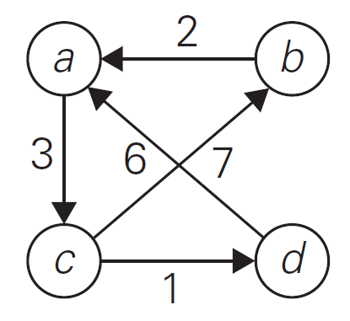
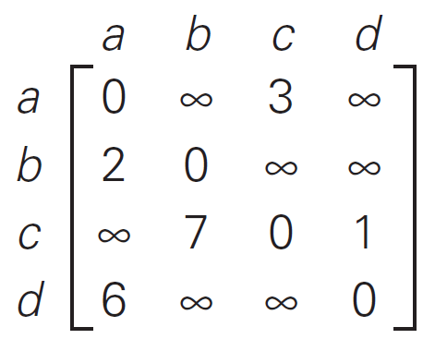
Example: All pairs shortest paths

Slide 6
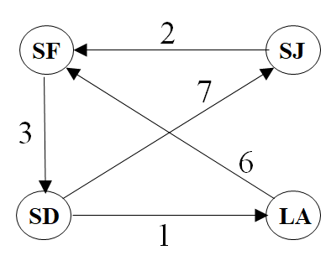
Basic Idea (1 of 2)
It’s similar to the Warshall’s algorithm.
  We consider each vertex one by one.
Example

Slide 7
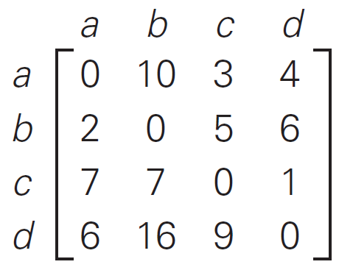
Basic Idea (2 of 2)
We calculate n-by-n matrices D⁽⁰⁾, D⁽¹⁾, D⁽²⁾, D⁽³⁾, … D^{(n)} where D^{(k)}[i, j] is the shortest path between the vertex i to vertex j that uses only vertices from 1 to k as intermediate nodes.
Example
D⁽⁰⁾
D⁽⁴⁾

Slide 8
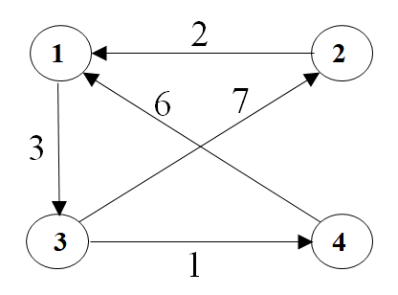
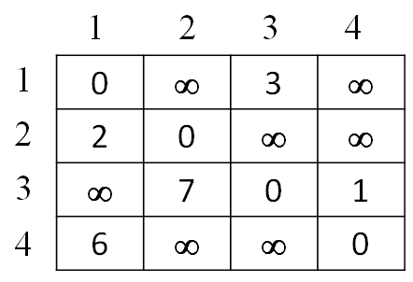
Example (1 of 5)
D⁽⁰⁾ =

Slide 9
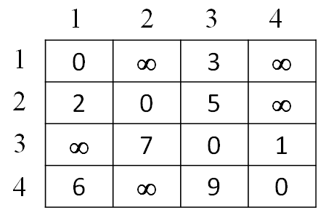
Example (2 of 5)
D⁽¹⁾ =

Slide 10
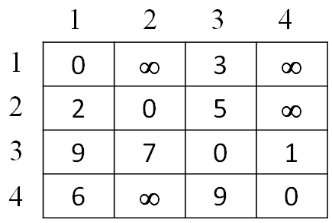
Example (3 of 5)
D⁽²⁾ =

Slide 11
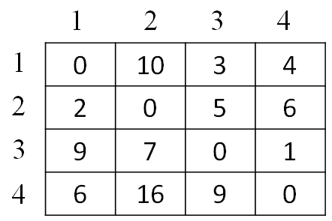
Example (4 of 5)
D⁽³⁾ =

Slide 12
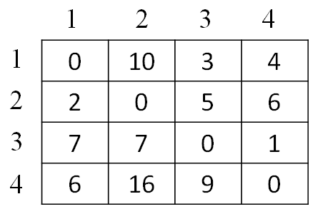
Example (5 of 5)
D⁽⁴⁾ =

Slide 13
Exercise (1 of 2)

Slide 14
Exercise (2 of 2)

Slide 15
Recurrence of Floyd’s Algorithm

Slide 16
Time Complexity

Slide 17
Puzzle

Slide 18
Solution

